Slide 1
Troubleshooting and System Management
Module 12

Slide 2
Module Objectives
Upon completion of this module, you will be able to:
Perform troubleshooting steps associated with:
Login Issues
Operating Systems and Browser Specific Issues
Hardware Issues
ESM and ESMI Issues
List, define and react to McAfee Health Monitoring Flags

Slide 3

Module Topics
McAfee Technical Support
Login Troubleshooting
Operating System and Browser Specific Troubleshooting
Hardware Issues
McAfee Health Status Flags
ESM and ESMI Troubleshooting

Slide 4
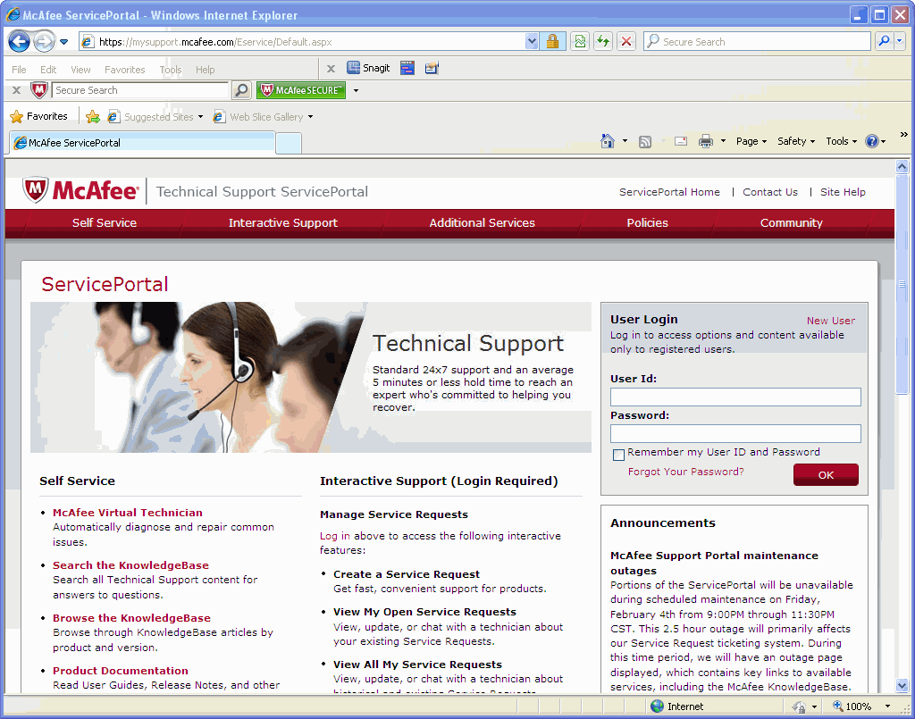
McAfee Technical Support
You can contact Technical Support via Phone (1-800-937-3337) or the Technical Support ServicePortal:
https://mysupport.mcafee.com/Eservice/Default.aspx
Product Documentation
Access to the Knowledge Base
Create Service Requests(requires login and grant number)
Notes:
McAfee Technical Support
ServicePortal (http://mysupport.mcafee.com)
The Technical Support ServicePortal contains access to many support resources. It is the best location to find Product Documentation, search the Knowledge Base for commonly found issues and open and check the status of service requests.
Web Gateway Extranet (https://extranet.webwasher.com)
The Web Gateway Extranet is where you should go if you wish to download the latest Web Gateway version or to get your license.
McAfee Customer Service (http://service.mcafee.com) 1-866-622-3911
If you need a user ID for the Extranet or Service Portal you should contact McAfee Customer Service (service@mcafee.com). Customer Service can also help with:
Product Licensing Issues
grant ID lookups
Problems viewing the ServicePortal or Extranet

Slide 5
Login Troubleshooting
ESM Fails to Communicate with the Client
When the ESMI client initially loads up, it communicates with the server to validate its version and to test the communication between the ESM and the client. If the ESM fails to communicate with the client, you will be prompted with a message on the login screen indicating that there was a failure communicating with the ESM. If you receive this error, do the following:
Make sure that the ESM is powered on and connected to the network.
If the database was not shutdown correctly, the database could be rebuilding. Depending on the amount of data on the ESM, this process could take several hours.
You may need to contact McAfee Support for further troubleshooting.

Slide 6
Login Troubleshooting
Client Fails Version Validation Test
When the ESMI client is loading up after a update it may fail a version validation test. A pop-up window will display the version of the application that is currently running and the version that is available on the ESM. If this problem occurs, it means that you are running an older version of the application than what is available on the ESM. To fix the problem, follow the steps described below.
Leave the ESM login page.
Clear your browser's cache by doing one of the following:
If you use Internet Explorer, go to your browser and select Tools > Options > Delete Files
If you use Mozilla FireFox, go to your browser and select Tools > Options > Advanced > Network and select Clear Now under the cache options.
After clearing the browser's cache, navigate back to the ESM's login page.
This should allow you to retrieve the latest version of the software from the ESM. If the problem still exists, contact McAfee Support.

Slide 7
Login Troubleshooting
ESM is Rebuilding
A problem that may occur when the ESMI client is loading is the ESM database may be in a state of rebuilding. This could occur after an unclean shutdown of the database which may cause data corruption (for example, the ESM is shut off due to a power outage) or following an ESM software upgrade that requires a database rebuild. If you receive this error:
Wait until the database rebuilding process completes. This process could take several minutes or several hours depending upon the amount of data in the database.
The ESMI will automatically attempt to reconnect to the ESM after 5 minutes. Optionally, you can attempt to reconnect immediately by clicking on the Attempt to Reconnect Now button.
If a rebuild takes longer than 24 hours, contact the McAfee Technical Support so an assessment can be made on the rebuild process.

Slide 8
Login Troubleshooting
ESM is Backing Up or Restoring the Database
If the Checking Version dialog opens when you launch the ESMI, the ESM could be performing a full backup or a full restore, which can take an extended period of time. While a full backup or restore is being performed, the ESM is offline.
During this time, the system will try to reconnect once every 5 minutes. When the process is completed, the Login screen will appear.
If you want to attempt a reconnection manually, click on the Attempt to Reconnect Now button. If the process is complete, the Login screen will open.

Slide 9
Login Troubleshooting
Unable to access the ESMI Desktop web interface
If you cannot access the web interface, but it is still possible to access the ESM via SSH the ESM web server may need to be restarted. To resolve this issue try the following:
Type the following command and press ENTER: ps -auxf You will see output similar to the following near the bottom of the screen: nobody 10264 0.0 0.0 0 0 ? Z May12 0:00 \_ [httpd] <defunct> nobody 10267 0.0 0.0 0 0 ? Z May12 0:00 \_ [httpd] <defunct> nobody 10268 0.0 0.0 0 0 ? Z May12 0:00 \_ [httpd] <defunct>
Run the following command: service httpd restart
The system will restart httpd and you will be able to access the web interface.

Slide 10
Login Troubleshooting
Unable to SSH or login to the ESM
If you cannot login via SSH to the McAfee ESM appliance or login in via your web browser to the ESMI desktop it is possible the ACL feature on the ESM has blocked users from accessing the ESM. To resolve this issue try the following:
Clear the ACL list using the LCD menu on the ESM appliance by following the menu options on the LCD.
If this does not resolve your login issues contact the McAfee support team.

Slide 11
Login Troubleshooting
The NGCP password for the ESMI desktop has been lost
To resolve this issue perform the following steps:
Log on to the ESM using SSH or via a keyboard and monitor directly connected to the appliance.
Copy the following files located in the “/usr/local/ess/data” directory off of the system to provide to the McAfee technical support team:
ngcp.dfl
Users.blob
Users.data
Submit files to the McAfee technical support team.

Slide 12
Login Troubleshooting
The root password for a device has been lost
To resolve this issue perform the following steps:
Use a bootable Linux distribution to gain access to the device.
Mount the root partition.
Edit the password file by typing:
vi /etc/shadow
Type i for insert mode and remove the password string following root using the X key
root:$1$SIK1cQlp$K5JapCDuAPzdnwHT0dgPO/:14726:0:99999:7:::
Save and exit the field by pressing ESC, and typing :wql
Reboot the system and log in as root with a blank password.
When you are logged in reset the root password by running the following command:
Echo root: (new password) | chpasswd -m

Slide 13
Login Troubleshooting
User can login to ESMI but they have no rights
After setting up Active Directory login, the user can login into the ESMI desktop, but they have no rights and cannot see anything. This issue is typically caused because the Active Directory group that the user belongs to has not been added to the groups in the ESMI desktop. This issue can also occur if the group name in Active Directory and the group name in the ESMI desktop are not exact text matches. To resolve this issue perform the following steps:
Ensure that a valid Active Directory group is specified in the ESMI desktop by entering the following command on the command line to see which groups the user belongs to:
nkinit -e <hex value of password> -u username
This is an example of a successful login with the listed groups: NitroSecurity-ESM-5750R /usr/local/ess/data # nkinit -e 6E6974726F736563 -u nitro success=Ok groups=Domain Users,Nitro Log Mgmt
This is an example of a valid user, but the login failed because of a bad password: NitroSecurity-ESM-5750R /usr/local/ess/data # nkinit -e 1111111111111111 -u nitro success=NotOk kinit: Preauthentication failed while getting initial credentials
This is an example of an invalid user: NitroSecurity-ESM-5750R /usr/local/ess/data # nkinit -e 6E6974726F736563 -u nitro_bogususer success=NotOk kinit: Client not found in Kerberos database while getting initial credentials

Slide 14
Operating System and Browser-Specific Issues
Internet Explorer Users
Under certain conditions, Internet Explorer users may not be able to authenticate against the ESM browser session. Communication between client and server requires secure settings for the browser session. To define these settings, do the following:
Select Internet Options on the Tools tab.
Select the Advanced tab and scroll down to the Security section. Ensure you set the following:
Use SSL 3.0
Use TLS 1.0
Click OK.
Restart the browser.

Slide 15
Operating System and Browser-Specific Issues
Netscape Users
Netscape users must define the following settings.
Select Options from the Tools tab.
Select Tab Browsing and set the following:
Under Open links from other applications in:
a new window
Under Tab Browsing:
uncheck Open a new tab instead of a new window and Open non-requested pop-ups in a new tab.
Select the device in the My Settings section and uncheck Open requested pop-ups in a new tab.
Click OK.
Restart browser.

Slide 16
Operating System and Browser-Specific Issues
64-bit Flash
Adobe does not yet produce a 64-bit Flash plugin for Linux.
On most 64-bit Linux setups, you can run 64-bit or 32-bit binaries (e.g., a 64-bit or 32-bit Firefox).
However, if Firefox is 64-bit, its plugins must also be 64-bit.
There is a 64-bit to 32-bit wrapper to use on 64-bit Linux if you are using a 64-bit Firefox, but its abilities to translate are limited.

Slide 17
Operating System and Browser-Specific Issues
ESM Login Screen Does Not Come Up on Linux Browser
If the ESM login screen does not open and you are on a Linux browser, it is possible that the Flash Player is old or out of date.
Upgrade to the latest version of Flash Player at http://www.adobe.com.

Slide 18
Operating System and Browser-Specific Issues
Login - unable to get the certificate using Firefox using IPv6 address
When navigating to an ESM via Firefox using the IPv6 address you see the following certificate error:
An error occurred during a connection to 2001:470:b:654::2:72:443. Peer's certificate issuer has been marked as not trusted by the user. (Error code: sec_error_untrusted_issuer)
This is a known issue in Mozilla Firefox and for more information visit: https://bugzilla.mozilla.org/show_bug?id=633001
A workaround is to perform the following:
Add an entry to your hosts file to map the IP address to a name. For example the host file entry might be:
2001:470:b:654::2:51 MyESM
You can then point your browser to the following URL: https://MyESM/Application.html

Slide 19
Operating System and Browser-Specific Issues
Export/Download Troubleshooting When Using Windows 7
By default, Windows 7 ships Internet Explorer 8 (IE8) with the Internet Protected Mode on. If you attempt to use the Export or Download functionalities in the ESMI with IE8 in this mode, they will be disabled. To resolve this problem, you must designate McAfee as a "trusted site" or turn off the Protected Mode setting. To disable Protected Mode, do the following:
Open the IE8 browser.
Click on Tools in the top-right corner.
Select Internet Options. The Internet Options dialog will open.
Click on the Security tab.
Click on the Enable Protected Mode checkbox to remove the check.
Click OK.

Slide 20
Hardware Issues
Beeping during initial startup
There are a few beeps that are normal; however, some hardware errors will produce a beep pattern or a post code. This might indicate a memory problem.
Continuous beeping, high pitched beeping: This indicates a possible problem with the RAID system or one of the drives.
Call McAfee Technical Support.
Solid tone: This is reported by the motherboard, and is usually related to a power supply problem. On systems with redundant power supplies, there will be an LED on the back indicating the power supply status. If the LED is green, the power supply is not the problem.
If you hear this alarm, call McAfee Technical Support for additional steps.

Slide 21
Hardware Issues
How to obtain the serial number from a device
You may need to gather the serial number from a McAfee SIEM device for technical support or for you own account records. To do this execute the following commands after you have established an SSH session with the device:
dmidecode | less (manually find the serial number for the system)
dmidecode | less | grep ‘Serial Number’ (should be the first Serial Number in the list)

Slide 22
Hardware Issues
Beeping during initial startup
There are a few beeps that are normal; however, some hardware errors will produce a beep pattern or a post code. This might indicate a memory problem.
Continuous beeping, high pitched beeping: This indicates a possible problem with the RAID system or one of the drives.
Call McAfee Technical Support.
Solid tone: This is reported by the motherboard, and is usually related to a power supply problem. On systems with redundant power supplies, there will be an LED on the back indicating the power supply status. If the LED is green, the power supply is not the problem.
If you hear this alarm, call McAfee Technical Support for additional steps.

Slide 23
Update and Upgrade Issues
How to ensure the update file is not corrupt
It is not uncommon for a file to become corrupt when downloading it from a remote site, as is required when downloading software updates. It is a recommended best practice to always check the downloaded file to ensure it has not become corrupt. To do this for McAfee SIEM devices perform the following steps:
SSH into the device
Change the directory to /usr/local/ess/SoftwareUpdates
Type the following command: md5sum <filename_of_downloaded_file> This will output a long hexadecimal value
Download the md5 file from the site where you got the software download from.
Open the md5 and verify that the long number in the md5 file matches the one calculated using the md5sum command

Slide 24
Update and Upgrade Issues
Troubleshooting Upgrade to Version 9.1.0
After you upgrade to version 9.1 from versions 9.0.x, you must re-key all of the devices. Previous device keys will be invalid so you must export a new one from 9.1. To do so:
Re-write any device settings (e.g., Data Sources, DB Servers, VIPS, Risk Manager) to the device to ensure 9.1 settings are applied.
Roll out Policy to all upgraded 9.1 devices.
After rollout to a Nitro IPS device be sure to take the device out of bypass mode on the Device Configuration > Interfaces dialog

Slide 25
McAfee Health Status Flags
With ESMI desktop, you will occasionally see Red ( ), Yellow ( ), and White ( ) flags in your device tree. The following list provides possible reasons for each flag. To determine what is causing your specific issue, you will need to view the device log.
Critical – ( )
Bypass mode
Deep Packet Inspector not running
Firewall alert program (ngulogd) not running
Database not running
Oversubscription mode
Control channel not running
RDEP or Syslog programs not running
Health Monitor unable to communicate with the Deep Packet Inspection controller program
Warning – ( )
Hard drive partition free space low
Fan speed alert
Temperature alert
High CPU load
High swap space usage
Network errors
Problem with a remote mount point
Remote mount point free disk space low
All data source collectors that have not received communication from a data source for at least 10 minutes
Data source collector not running
Health Monitor unable to get a valid status from a subsystem
Informational – ( )
A flag appears whenever a subsystem recovers from a Warning or Critical status.
Notes:
The following is a detailed description of each flag.
Bypass mode - The Health Monitor observes the state of the bypass NIC, if the IPS has one installed. If the Health Monitor detects that the NIC is in bypass mode, it sets this alert. Possible reasons why the NIC might be in bypass mode include the failure of a critical system process, manually setting the device into bypass mode, or other failure. You can take the device out of bypass mode using the Interfaces screen of the Device Configuration tab of the Device Properties menu.
Deep Packet Inspector not running - A Health Monitor alert is triggered if the Health Monitor detects that the Deep Packet Inspector (DPI) has malfunctioned. It is possible that the DPI can recover from the malfunction without intervention. If it does not recover in a reasonable amount of time, restarting the device might solve the problem.
Firewall alert program (ngulogd) not running - A Health Monitor alert is triggered if the Health Monitor detects that the Firewall Alert Aggregator (FAA) has malfunctioned. It is possible that the FAA can recover from the malfunction without intervention. If it does not recover in a reasonable amount of time, restarting the device might solve the problem.
Database not running - A Health Monitor alert is triggered if the Health Monitor detects that the NitroEDB Database Server has malfunctioned. A restart of the device might solve the problem, but the database might need to rebuild. A rebuild can take as long as 90 minutes.
Oversubscription mode - If the network the IPS is monitoring is busier than what the IPS can handle, there might be network packets that are not inspected. When this occurs, the Health Monitor flags an alert indicating the IPS has been oversubscribed for the network it is monitoring. By default, the oversubscription mode value is set to drop. To change the value, navigate to the Policy Editor and click Edit. In the Variables tab, expand the packet-inspection variable and select the OVERSUBSCRIPTION _MODE inherit checkbox to change the value. Pass and drop are the only two allowed values for this variable.
Continued on next page

Slide 26
Hidden
Notes:
Control channel not running - If the Health Monitor detects that the process that services the communication channel with the ESM has failed, it triggers this alert. Occasionally a reboot of the device will remedy the problem.
RDEP or Syslog programs not running - If there is a malfunction with the subsystem that handles the specific third-party data sources (such as syslog or SNMP), a critical alert is raised. A warning-level alert is raised if the collector has not received any data from the specific third-party data source in a certain amount of time. This is to indicate that the data source might be down or not sending data to the Receiver as expected.
Health Monitor unable to communicate with the Deep Packet Inspector controller program - The Health Monitor was unable to communicate with the Deep Packet Inspector to retrieve its current status information. This could mean that the control program is not running, and network traffic might not be passing through the IPS. Occasionally, reapplying policy will resolve the issue.
System logger not running - If the Health Monitor detects the system logger is not responding, it triggers this critical alert. Occasionally, a reboot of the device will remedy the problem.
Hard drive partition free space low - The Health Monitor checks how much free disk space is available in the system. If the amount of free disk space gets critically low, it will flag an alert.
Fan speed alert - The Health Monitor observes the RPMs (rotations per minute) of the cooling fans in the device. If the hardware sensor finds that any of the fans spin slowly or not at all, a health monitor alert is triggered. Until the fan can be replaced, it is best to keep the device in an air-conditioned room to prevent permanent damage to the hardware.
Temperature Alert - The Health Monitor observes the temperatures of several critical components inside the device. If it detects any of the temperatures to be above a certain threshold, the Health Monitor will trigger an alert. It is best to keep the device in an air-conditioned room and check to see if anything might be blocking the airflow through the device to prevent permanent damage to the device hardware.
High CPU Load - The Health Monitor checks the CPU load of the device. If the load is very high for an extended amount of time, an alert is generated. It might be possible that the device is oversubscribed for the network it is monitoring, or a process running on the device is malfunctioning.
High swap space usage - Occasionally a device will use the hard disk for swap space to free up main memory. If the Health Monitor detects excessive swap activity, it will trigger an alert. A possible reason for this condition is that the device might be oversubscribed for the network it is monitoring.
Network errors - If the Health Monitor detects network errors or excessive collisions on the network, an alert is generated. There can be a number of reasons for the network errors, anywhere from a large collision domain to bad network cables.
Problem with a remote mount point - This error indicates that there is a problem with a remote mount point.
Remote mount point free disk space low - This error indicates that the remote mount point free disk space is low.
All data source collectors that have not received communication from a data source for at least 10 minutes - This error indicates that the Receiver has not received any communication from a data source for at least 10 minutes.
Data source collector not running - If there is a malfunction with the subsystem that handles the specific third-party data sources (such as syslog or SNMP), a critical alert is raised. A warning-level alert is raised if the collector has not received any data from the specific third-party data source in a certain amount of time. This is to indicate that the data source might be down or not sending data to the Receiver as expected.
Health Monitor unable to get a valid status from a subsystem - This error indicates that the health monitor was unable to get a valid status from a subsystem.
Subsystem recovery from a warning or critical status - The alerts coming from the Health Monitor itself can range between informational alerts, warnings, as well as critical alerts. When the Health Monitor is started and stopped, an informational alert is generated. If the Health Monitor has trouble communicating with other subsystems on the devices, an alert is also generated. Viewing the event log may provide details on the causes of the warning and critical alerts.

Slide 27
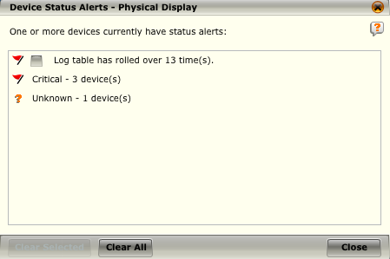
McAfee Health Status Flags
The Device Status Alerts screen allows you to view an overall summary of the status alert(s) for the devices that are associated with the system or the group that is selected on the System Navigation Tree.
The status indicates the overall health of your devices. Note that you can only get to this screen by clicking on a status flag ( , , , ) next to a System or Group node in the System Navigation Tree.

Slide 28
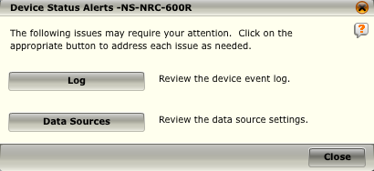
McAfee Health Status Flags
The Device Status window will display informative text and buttons that will launch you into areas that should be accessed in order to further understand the problem or resolve the issue. Note that you can only get to this screen by clicking on a status flag ( ) next to a device node on the System Navigation Tree.
When you click on the Log button, the System Log (for Local ESM) or Device Log screen will open showing a summary of all actions that have taken place on the system (for Local ESM) or device(s).
Notes:
The buttons are enabled or disabled on the screen depending on the kind of problems that need to be fixed or looked at on the device. The Device Status screen may look different depending on which device you selected on the device tree. If you click on Virtual Device, Data Source, or Database Servers, you will be able to review a list of the virtual devices, data sources, or database servers on the device.

Slide 29
ESM and ESMI Troubleshooting
How to initialize a callhome
When contacting support, it is not uncommon for them to request a callhome session to aid with troubleshooting a particular problem. To establish this call from home session perform the following:
Use the following steps to initialize the callhome through the GUI:
Log in to the ESM as NGCP user.
Select System Properties.
Select ESM Management.
Click Connect.
Inform Technical Support of the connection and the IP address given.
Initialize from SSH session
Log in as root and type the following case-sensitive command, and then press ENTER: callhome
Type ifconfig and get the tun0 address for Technical Support.
Inform Technical Support of the connection and the IP address given.
Notes:
Check that the following port and IP addresses are open for the version you are running:
7.X or lower - Callhome goes over port 443 to 69.20.166.229
8.1 through to 8.4.0 - Callhome goes over port 443 to 69.20.171.242
8.4.1 or higher - Callhome goes over port 443 to 69.20.166.229
If traffic is going out over a proxy server to the Internet, the proxy settings must be filled in on the Network Settings tab under Network Properties.

Slide 30
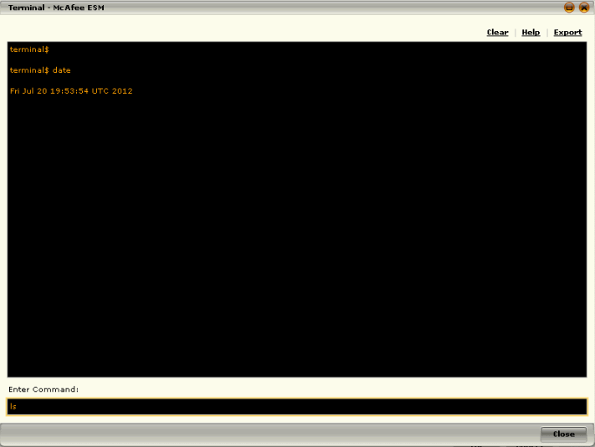
ESM and ESMI Troubleshooting
How to access the terminal via the GUI
The Terminal button is used to enter Linux commands on the ESM. The terminal is for advanced users only and should only be used under the direction of McAfee Support personnel for emergency situations.
To access the ESM Management and terminal:
Click on the System node on the System Navigation Tree.
Click on Properties in the Actions Pane. The System Properties screen will open.
Select ESM Management on the System Properties menu. The ESM Management screen will open and the terminal button will be available.
Notes:
The terminal is only a partial batch mode emulator and not all commands are available. See below for a list of available commands. The terminal does not keep track of a present working directory. Attempting to 'cd' to another directory is ineffectual. Full path names must be used. The > or >> operators do not work; all results are returned to the screen. Upon clicking on the Terminal button, you will be prompted for your password. Enter the password for that account and click OK to gain access to the Terminal window. Use the up and down arrows to scroll through the command history when on the prompt line.
Additionally, you can clear the contents of the terminal window by clicking on Clear in the top right of the screen. You can also export the contents of the current session within the terminal by choosing the Export option. The Export option allows you to view the results by saving them to a file location or viewing them in a text viewer. Note that the export will not include any results that have been cleared from the terminal window during the current terminal session.
Continued on next page

Slide 31
Hidden
Notes:
Available commands
getstatsdata
ps
grep
ifconfig
kill
sensors
service
cat
rm
iptables
updatedb
cp
echo
date
ethtool
df
tar
netstat
sar
tail
locate
tcpdump -c -w
ip6tables
Available commands that are modified before execution
ll - changed to 'll --classify’
ping - changed to 'ping -c 1’
ls - changed to 'ls --classify’
top - changed to 'top -b -n 1’
ping6 - changed to ‘ping6 -c 1’

Slide 32
ESM and ESMI Troubleshooting
How to export the ESMI login history
It is not uncommon to have a need to review who has logged into the ESMI desktop interface and to do so perform the following steps:
Log in to the ESMI desktop.
Go to System Properties.
Click System Log.
Select the time frame you want to view in your export.
Click View.
When the System log opens, click the funnel next to the word Category.
Deselect everything except Authentication, and click OK.
Click Export.
When the new screen opens, click OK.
Click OK to download the file.

Slide 33
ESM and ESMI Troubleshooting
How to manually set the time if no NTP server is available
If you do not have an NTP server you can manually set the ESM time to GMT by performing the following steps:
Use the following steps to manually set the time to GMT on the ESM:
Click System, Properties, System Information, and then click the System Clock (GMT) link.
De-select the Use NTP to automatically update the clock option.
Click the Calendar option to set the time to GMT manually.
Next, you can point all the other Nitro devices to the ESM as the NTP server. The following example describes how to do this for a Receiver:
Click Receiver, Properties, Receiver Configuration, NTP.
Enter the IP Address of the ESM, and then click OK.
Go to the Receiver Information page, and then click the Sync button next to Sync Receiver Clock.

Slide 34
ESM and ESMI Troubleshooting
Unable to download rules from the McAfee servers
The Policy Manager can be configured to download rules from McAfee on a periodic basis. If the rule downloads are not occurring regularly check the following:
In System Properties, Rules & Software, ensure that the Auto check checkbox is checked. If Check Now still returns an error, does the ESM have a valid Internet connection?
Is there a Proxy or Firewall that must be configured to allow the ESM to reach the Internet?
Are the ESM DNS settings correct?

Slide 35
ESM and ESMI Troubleshooting
The ESMI Desktop becomes unresponsive
The ESMI desktop can become slow, unresponsive, or frequently drop if the ESM is running very slow. ESM latency might be caused by a lot of paging into swap files on the hard disk. This is directly related to the configuration of each IPS, DBM, APM, ELM, and Receiver in the network, and their configurations and event/flow collection rates.
Tune the ESM and the devices it manages as follows:
Event and Flow Aggregation settings (use defaults)
Locate noisy rules or the most frequently triggered events and resolve or disable them
Tune Home_net to reduce false positives

Slide 36
ESM and ESMI Troubleshooting
Error: Unable to retrieve ELM archive. The log may have not been sent to the ELM yet
After navigating through the events on the ESMI and attempting to view the ELM log by selecting the ELM Archive tab under Details, you see the following error:
“Unable to retrieve ELM archive. The log may have not been sent to the ELM yet.”
The log file has not been sent to the ELM from the other SIEM devices yet. The McAfee SIEM products are working as designed. In the 9.0.2a release, the frequency that the logs were sent to the ELM was changed in the following way: Before 9.0.2a:
The ELM log file must be at least 5MB.
Log file is sent every 5 minutes.
9.0.2a and later:
The ELM log file must be at least 5MB.
Log file is sent every 12 hours.

Slide 37
ESM and ESMI Troubleshooting
How to determine if you are getting data in your data source
If you created a data source and you know that logs are being sent to the receiver, use the following steps to check if the data is actually getting to the Receiver:
Run the following command:
tcpdump -nni eth0 host <IP_Address of datasource>
If you see data, go to Step 2. If not, there could be a firewall blocking the traffic, or it might be sending to the wrong IP address.
Run the following command:
iptables -nvL
In the output displayed, the first 2 columns will be the packets sent and received, which will enable you to find the IP address of your data source. If there is data, go to step 3.
In NitroView, select the data source in question from the View drop-down, then select Device Status. If you see data, the data has been received. If you see data, but you are still not seeing events, verify your vendor and model. If the vendor and model are correct, call Technical Support.

Slide 38
If the Checking Version dialog opens when you launch the ESMI, the ESM could be performing a full backup or a full restore, which can take an extended period of time.
True
False
Notes:
Answer: True

Slide 39
If the NGCP password has been lost you should do the following:
Contact support and provide them with the specified files from the receiver
Contact support and provide them with the specified files from the ESM
Request an RMA
Reset the root password with a live Linux Distro
Notes:
Answer: Contact support and provide them with the specified files from the ESM

Slide 40
The tool used to verify a software update did not become corrupted during a download is ____________ ?
sha1sum
md5sum
md5calc
sha1calc
rm –rf *
Notes:
Answer: md5sum

Slide 41
Port ______ needs to be open to the Internet for a callhome session to be established with the McAfee support team.
80
53
1029
443
22
Notes:
Answer: 443

